Slide 1

Smart Tourism System
Group No. 02
Jaynam Shah - 18104047
Harsh Shah – 18104072
Nada Rajguru - 19204005
Project Guide and Co-guide:
Prof. Anagha Aher and Prof. Nahid Shaikh

Slide 2
Contents
Introduction
Objectives
Problem Definition
Technological Stack
Review Suggestions (Given in Last meeting)
Proposed System Architecture/Working
Prototype Design Demonstration
Implementation Status
Status of Paper Draft & Targeted Conference

Slide 3
Introduction
The proposed smart tourism website is a travel website which provides with trip plans, hotel bookings, flight bookings, etc. and helps the end user find a suitable hotel / tour plan.
The website also provides with an itinerary of tour and shows nearby attraction places to visit in the vicinity of the end user or a hotel.

Slide 4
Objectives
To create and implement a smart tourism website to provide users with suggestions to tourist attraction spots, hotel booking, and tour planning using Django
To allow users to filter hotels through various parameters like budget, duration of stay, type of trip, recommended tourist spots, etc.
To provide customers with an itinerary for each day of trip as per user preference.
To implement an AI chatbot for basic user queries.

Slide 5
Problem Definition
Increasingly tourists are planning trips by themselves using the abundant information available on the web, however they still expect and want trip plan advisory services.
This project proposes a travel website which provides hotel booking system and a tour itinerary with day wise plan for the trip and recommends attraction places to visit in the vicinity of end user or a hotel.

Slide 6
Technological Stack
Frontend :
Html, CSS, JS
Backend / Database :
Django / SQL
AI Chatbot
ML : Content Based recommendation system

Slide 7
Review Suggestions
Provide user with attraction places near a hotel or user location.
Provide users with hotel and flight booking.
Provide users with different types of tours to customize the trip accordingly (business trip, family trip, etc.)
Implement Recommendation System

Slide 8
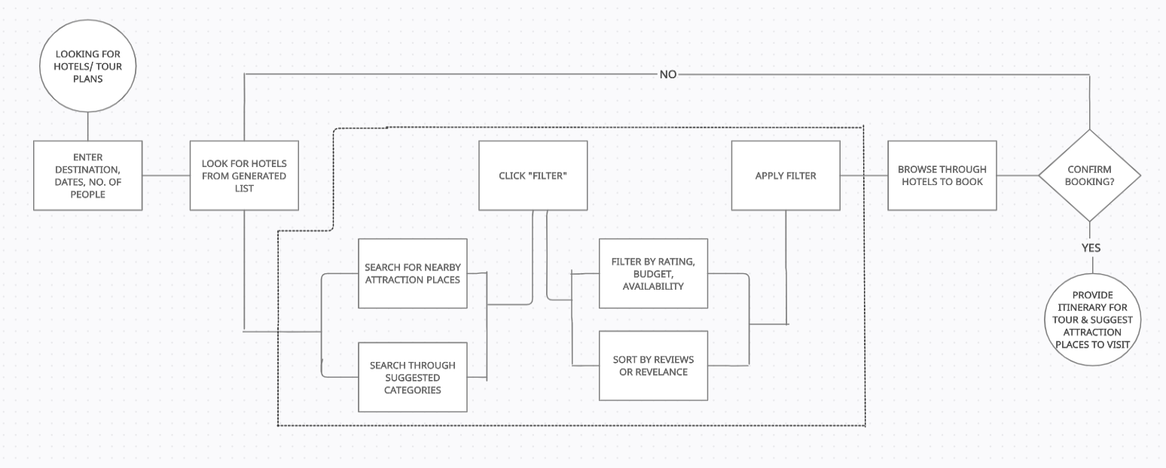
Proposed System Architecture/Working

Slide 9
Thank You...!!

